Slide 1


TATACARA PERMOHONAN PERMIT IMPORT BAGI PERSENDIRIAN SEMASA SITUASI COVID-19

Slide 2






1
Lantik Forwarding Agent (FA) yang berdaftar dengan
Jabatan Kastam dan Eksais Diraja (JKED)
2
Isi borang Trader Authorisation Form* dengan lengkap dan emel ke coa.renew@customs.gov.bn
(dengan tajuk: Lantikan Agen Kastam)
3
FA akan memohon permit import melalui sistem Brunei Darussalam National Single Window (BDNSW) setelah mendapat kelulusan JKED
Membuat pembayaran secara online dan emel resit pembayaran ke:
plantimport@agriculture.gov.bn, cc: plantbios@gmail.com
(Tumbuhan dan Produk Tumbuhan)
Atau
animalimport@agriculture.gov.bn, cc: animal.qu@gmail.com
(Haiwan dan Produk Haiwan)
4
Bagi Negara Pengeksport Malaysia (Sabah & Sarawak) :
Permit Import digital diterima melalui emel bagi Permit Import
Bagi Negara Pengeksport yang lain:
Pengimport akan mendapat perjanjian melalui emel bagi pengambilan Permit Import
5
*Muat Turun Borang Trader Authorisation Form dari link di bawah:
https://tradingacrossborders.mofe.gov.bn/Downloadable/Trader%20Authorisation%20Form.pdf

Slide 3

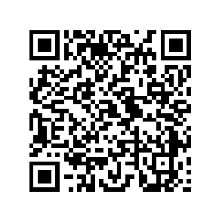

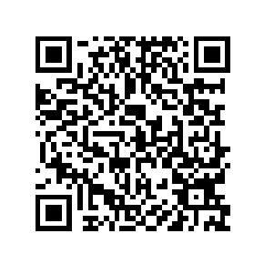
“TRADER AUTHORISATION FORM”
https://tradingacrossborders.mofe.gov.bn/Downloadable/Trader%20Authorisation%20Form.pdf
“SENARAI FORWARDING AGENT BERDAFTAR”
https://tradingacrossborders.mofe.gov.bn/Downloadable/List%20Of%20Forwarding%20Agent%202020.pdf

Slide 4
GUIDELINES ON APPLICATION FOR INDIVIDUAL IMPORT PERMIT DURING COVID-19 SITUATION

Slide 5
1
Assign a Forwarding Agent (FA) registered with
the Royal Customs and Excise Department (RCED)
2
Complete the Trader Authorisation Form* and email to
coa.renew@customs.gov.bn
(with subject title: Assigning Customs Agent)
3
FA applies for import permit through the
Brunei Darussalam National Single Window (BDNSW) after approval is given by JKED
Pay online and email payment receipt to:
plantimport@agriculture.gov.bn, cc: plantbios@gmail.com
(Plants and Plant Products)
Or
animalimport@agriculture.gov.bn, cc: animal.qu@gmail.com
(Animals and Animal Products)
4
5
For exporting country Malaysia (Sabah & Sarawak):
Receive Import Permit via email
For other exporting countries:
An appointment will be set up via email to collect the import permit over-the-counter
*Download the “Trader Authorisation Form” from the link below:
https://tradingacrossborders.mofe.gov.bn/Downloadable/Trader%20Authorisation%20Form.pdf

Slide 6
“TRADER AUTHORISATION FORM”
https://tradingacrossborders.mofe.gov.bn/Downloadable/Trader%20Authorisation%20Form.pdf
“LIST OF REGISTERED FORWARDING AGENTS”
https://tradingacrossborders.mofe.gov.bn/Downloadable/List%20Of%20Forwarding%20Agent%202020.pdf

